Slide 1
September 2023 Ridership Report
October 17, 2023 | Matt Moorman

Slide 2
Fixed-Route Ridership

Slide 6
*percentage points

Slide 7
*percentage points

Slide 8
Overall: 72.0%

Slide 15
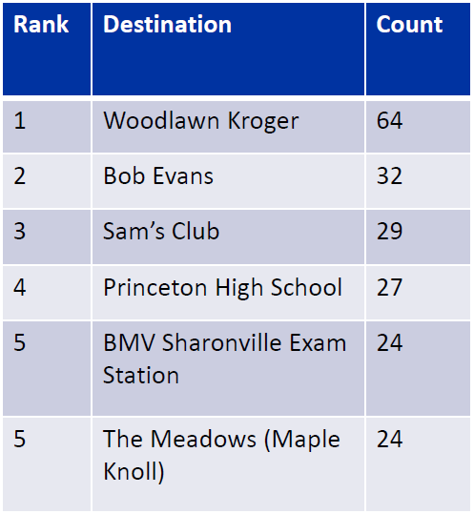
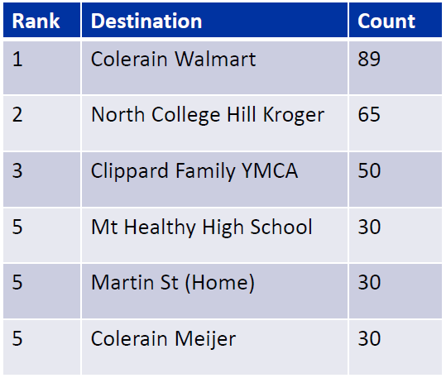
Springdale Zone Most Visited Locations
Northgate Zone Most Visited Locations

Slide 16
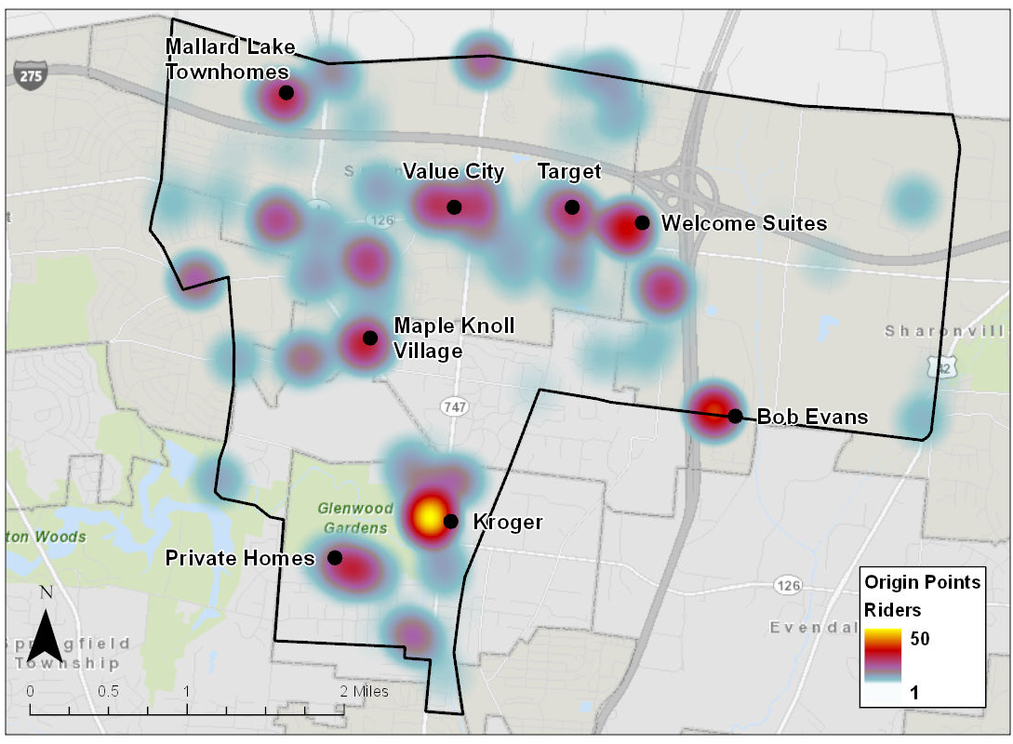
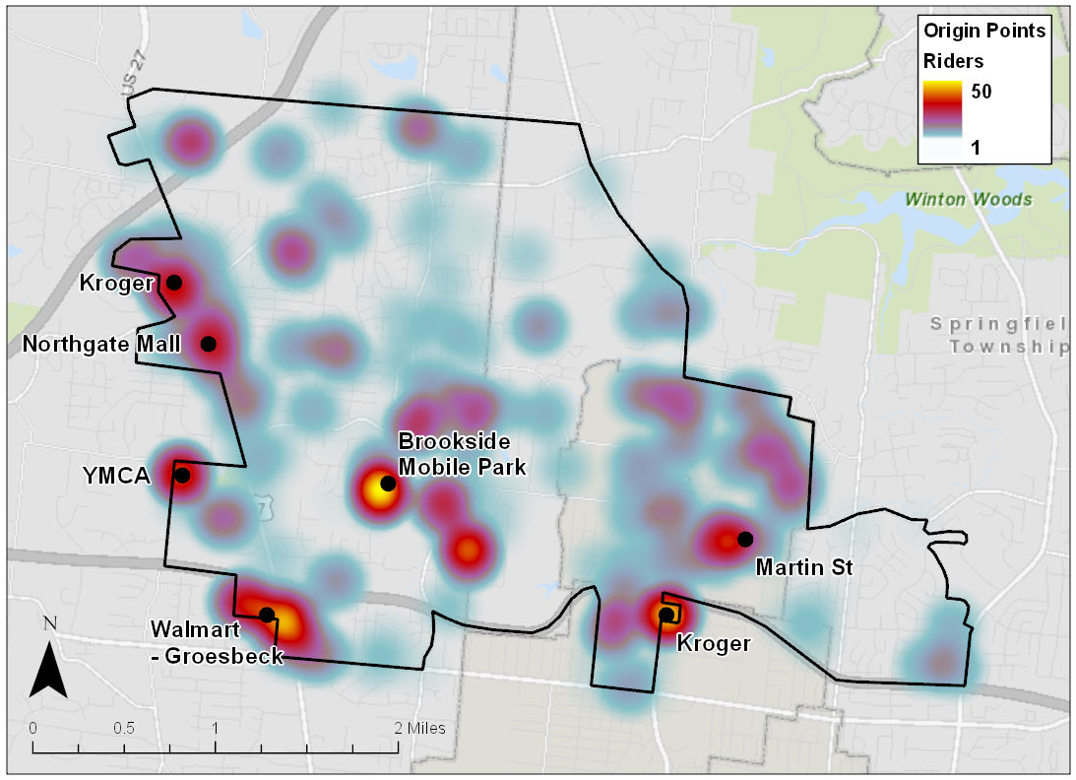
Springdale Zone Usage Map
Northgate Zone Usage Map

Slide 17
ACCESS Ridership

Slide 20
OTP: 87.8%

Slide 21
*percentage points

Slide 22
Route Level KPIs

