Slide 1
December 2023 Ridership Report
January 16, 2024 | Matt Moorman

Slide 2
Fixed-Route Ridership

Slide 6
*percentage points

Slide 7
*percentage points

Slide 8
OTP: 76.7%

Slide 12
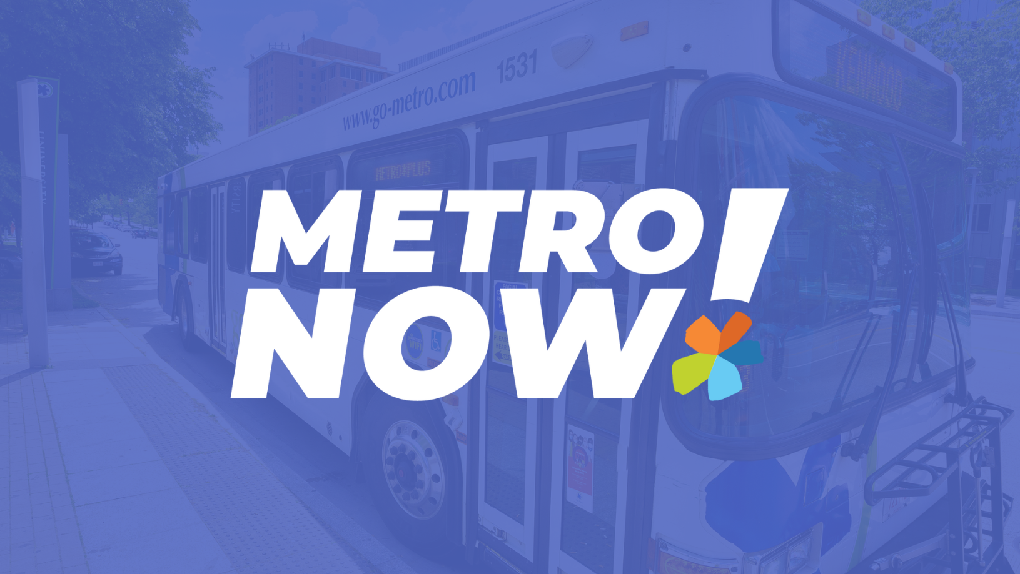

Slide 15
ACCESS Ridership

Slide 18
OTP: 89.7%

Slide 19
*percentage points

Slide 20
Route Level KPIs

