Slide 1
June 2023 Ridership Report
July 18, 2023 | Matt Moorman

Slide 2
Fixed-Route Ridership

Slide 6
*percentage points

Slide 7
*percentage points

Slide 8
Overall: 77.5%

Slide 12
ACCESS & MetroNow Ridership

Slide 15
OTP: 89.8%

Slide 16
*percentage points

Slide 17
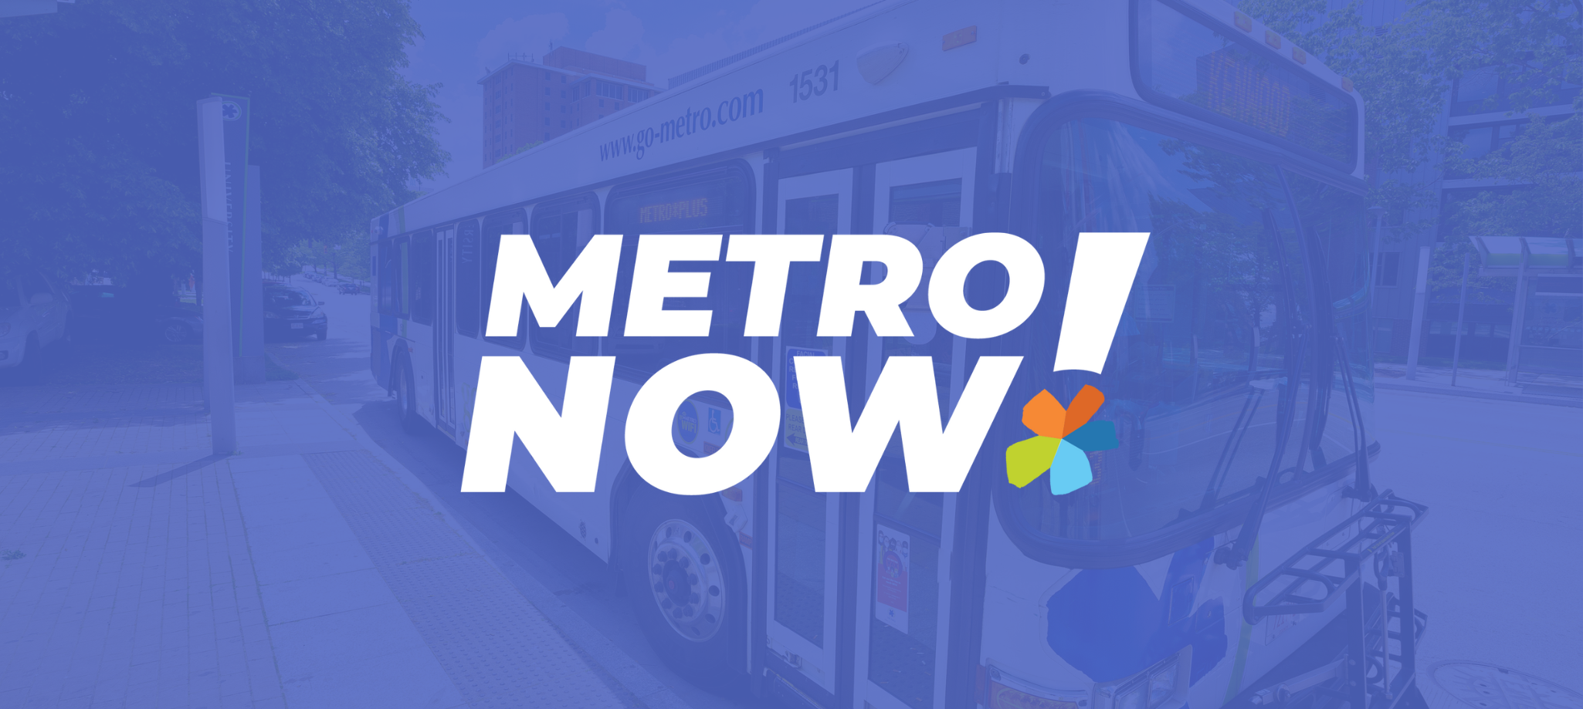

Slide 18
Route Level KPIs

