Slide 1
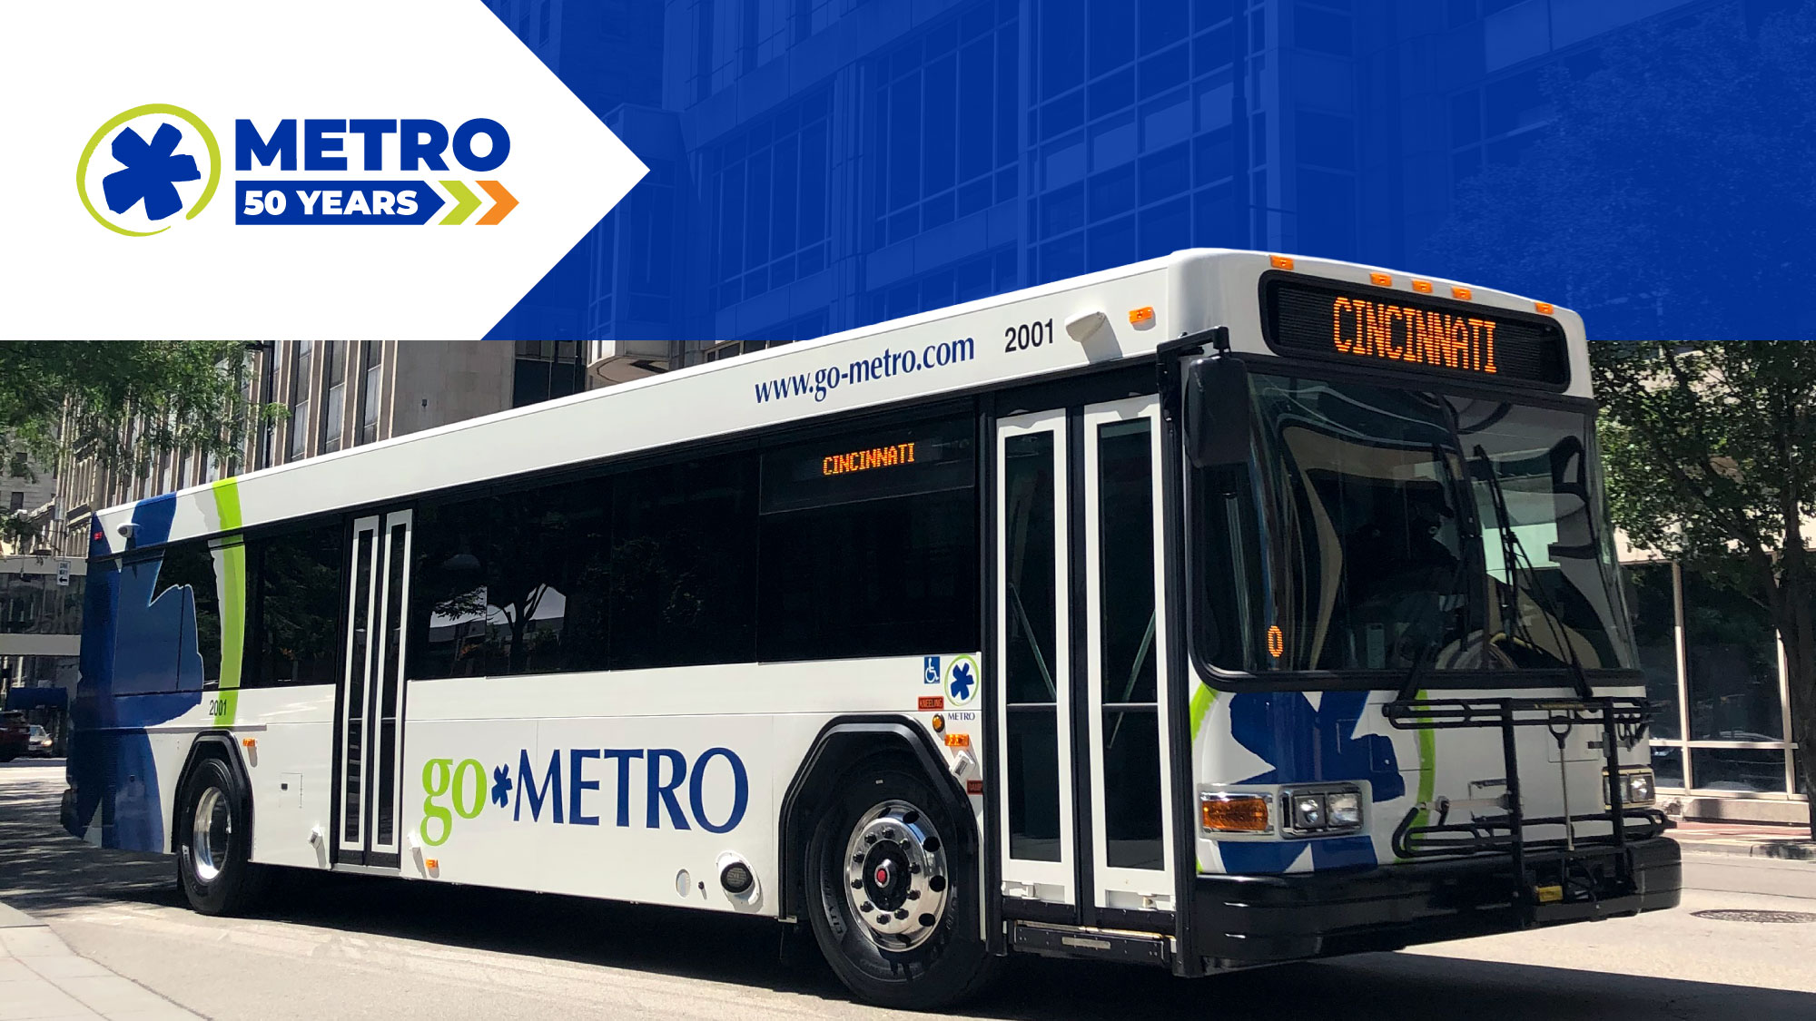
February 2023 Ridership Report
March 21, 2023 | Matt Moorman

Slide 2

Fixed-Route Ridership

Slide 3

Service | Feb-23 |  |  |  | Feb-22
 | Ridership | Budget | Budget Variance | % Budget Variance | Ridership | 2022 Variance | % Variance
Local | 978,586 | 828,589 | 149,997 | 18.1% | 638,233 | 340,353 | 53.3%
Express | 24,954 | 18,904 | 6,050 | 32.0% | 16,964 | 7,990 | 47.1%
Totals | 1,003,540 | 847,493 | 156,047 | 18.4% | 655,187 | 348,353 | 53.2%
Total (YTD) | 2,032,246 | 1,817,159 | 215,087 | 11.8% | 1,269,216 | 763,030 | 60.1%

Slide 5
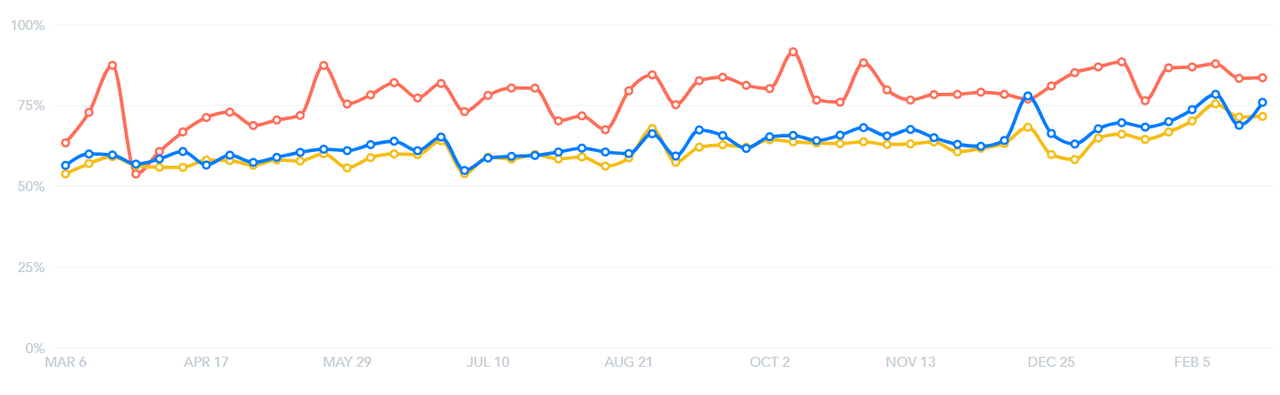
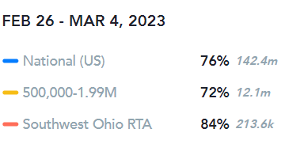
How SORTA’s Ridership Compares to the Rest of the Nation
(*from APTA Transit App)

Slide 6
Service | Feb 2023 Avg Daily | Feb 2023 Avg Daily Budget | Budget Variance | Feb 2022 Avg Daily | Feb 22- Feb 23 Variance
WEEKDAY | 42,647 | 36,703 | 17.0% | 28,290 | 50.7%
SATURDAY | 21,527 | 16,115 | 33.6% | 12,756 | 68.8%
SUNDAY | 16,125 | 12,245 | 31.7% | 9,589 | 68.2%

Slide 7
Local Service | Feb 2023 Actual KPI | Feb 2023 Budget KPI | Variance
Passengers Per Hour (PPH) | 18.6 | 15.9 | 2.7
Cost Recovery | 14.2% | 10% | 4.2%

Slide 8
Local Service | Feb 2023 Actual KPI | Feb 2023 Budget KPI | Variance
Passengers Per Trip (PPT) | 7.5 | 11.4 | -3.9
Cost Recovery | 4.0% | 19.0% | -15.0%

Slide 10
 | Actual | Total Trips | Pct. Of Trips Operated
Missed Trips | 1,775 | 62,000 | 97.1%

Slide 13

ACCESS Ridership

Slide 14
 | Jan 2023 Ridership | Jan 2023 Budget | Budget Variance | Jan 2022 Ridership | Jan 22- Jan 23 Variance
Total | 14,063 | 12,054 | 16.7% | 11,682 | 20.4%
Weekday | 12,862 |  |  | 10,820 | 18.9%
Saturday | 521 |  |  | 444 | 17.3%
Sunday | 680 |  |  | 418 | 62.7%
Total (Year-to-Date) | 14,063 | 12,054 | 16.7% | 11,682 | 20.4%

Slide 17
Access Service | Jan 2023 Actual | Jan 2023 KPI | Variance
Cost Per Passenger | $53.90 | $55.00 | -$1.10
On-Time Performance | 91.5% | 94.0% | -2.5%
Passengers Per Hour | 2.2 | 2.2 | 0
Cost Recovery | 8.0% | 14% | -6.0%

Slide 18

Route Level KPIs

