Slide 1
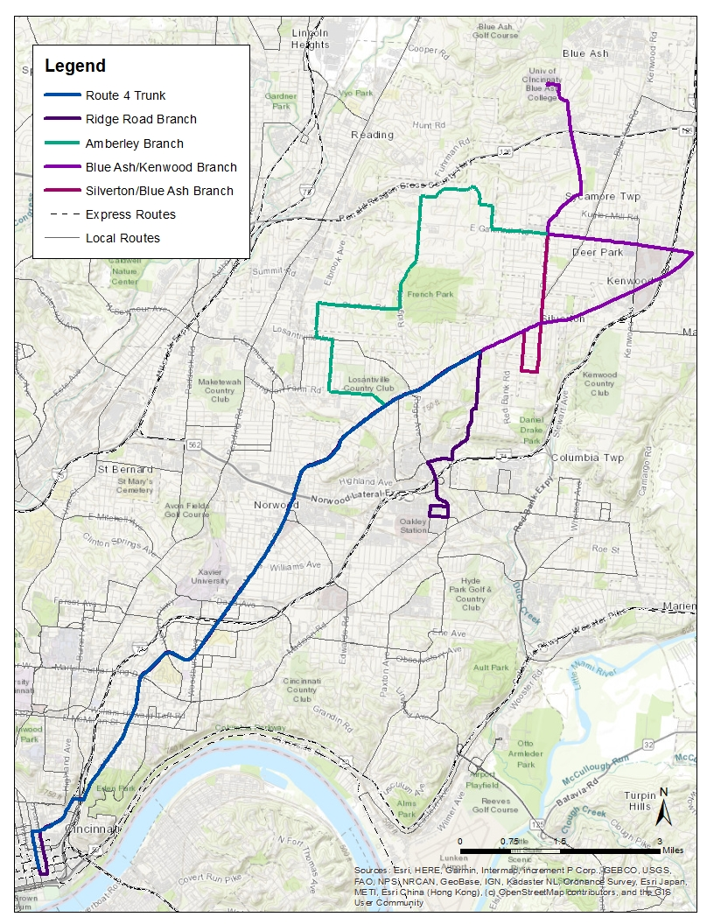
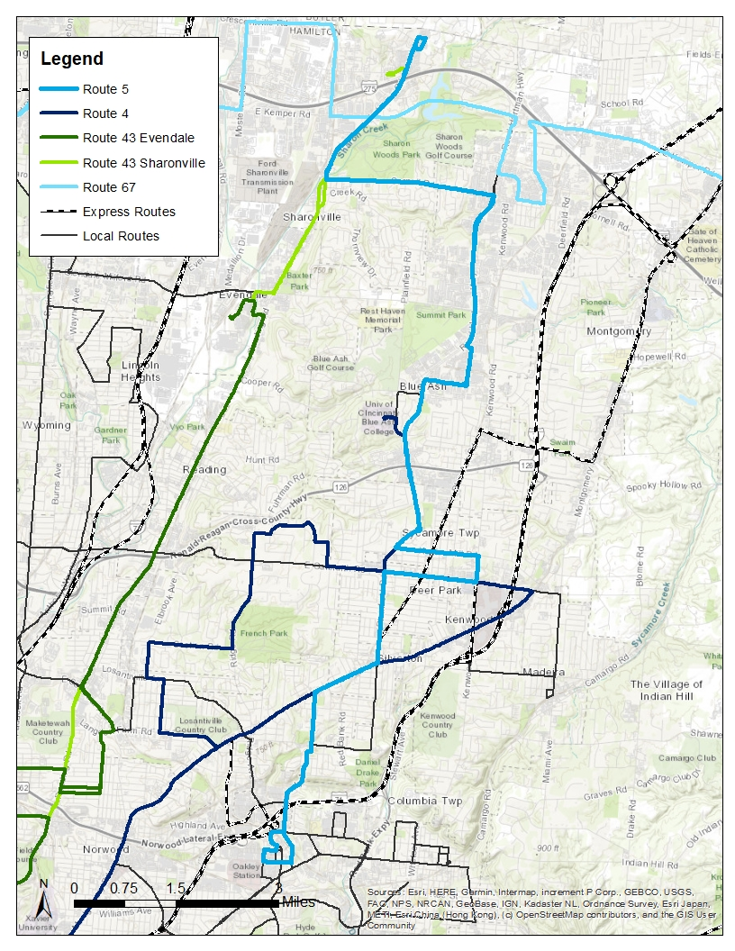
Route 4/Route 5: Current v. Proposed
UC
Blue Ash
Sharonville Plaza
UC Blue Ash
Walnut Hills High School
Oakley TC
Kenwood
GSQ
Oakley TC
Notes:
Madison Via OTC, R Marburg, R Alamo, L Ridge, R Highland, L Kennedy, R Woodford, L Plainfield, R Montgomery, L Kenwood, L Galbraith, R Plainfield, L UC Blue Ash, Via UC Blue Ash, L Plainfield, R Cooper, L Reed Hartman, R Malsbury, L Alliance, R Cornell, L Grooms, L Kemper, R Lebanon, R Kroger. Loop around.

Slide 2
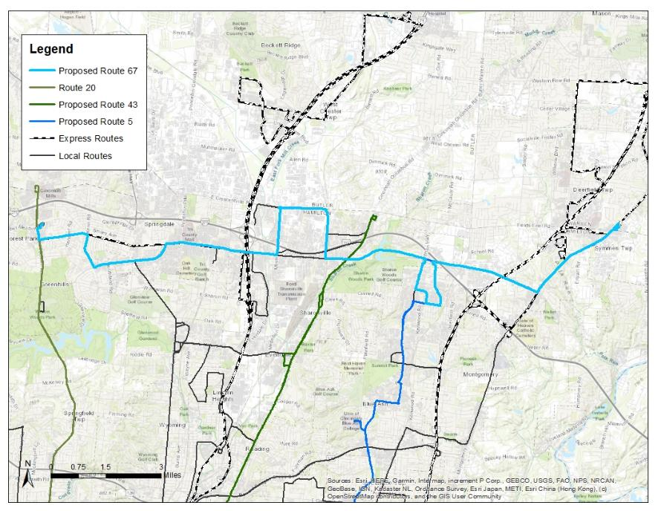
New Route 67: Kemper Crosstown
Meijer P&R
Forest Park P&R
Great
Oaks
16-Mile
Stand
Blue Ash
Notes:
Madison

Slide 3
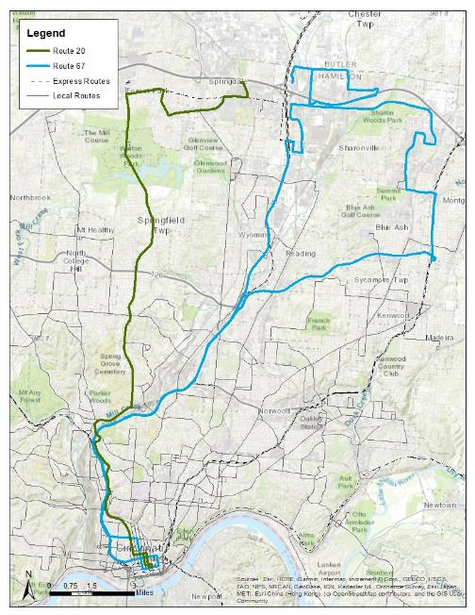
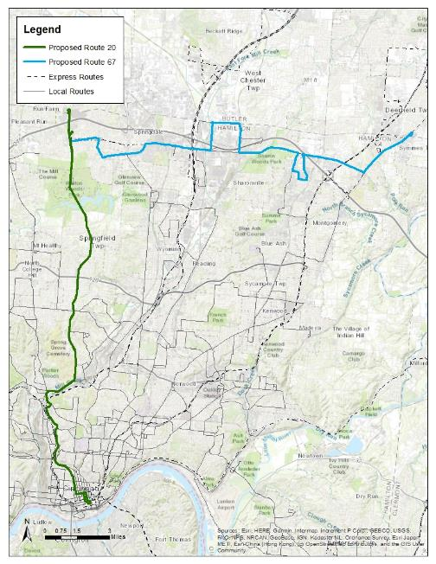
Route 20/Route 67: Current v. Proposed
Century Circle
Meijer/Cincy Mall
Meijer P&R
Forest Park P&R
Northside TC
Northside TC
GSQ
GSQ
Notes:
Madison

Slide 4
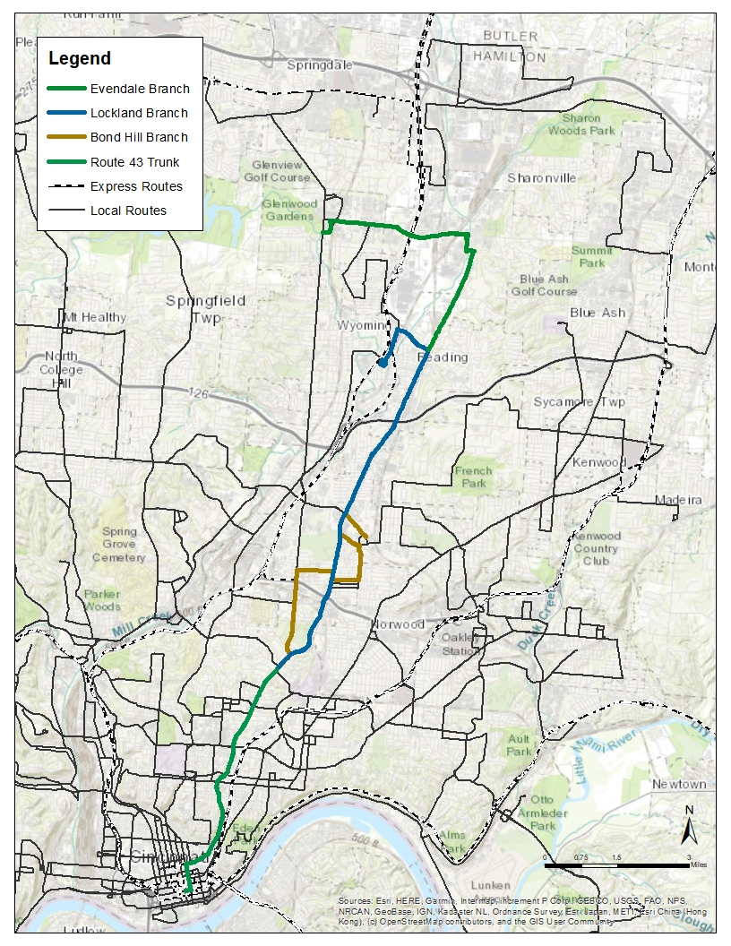
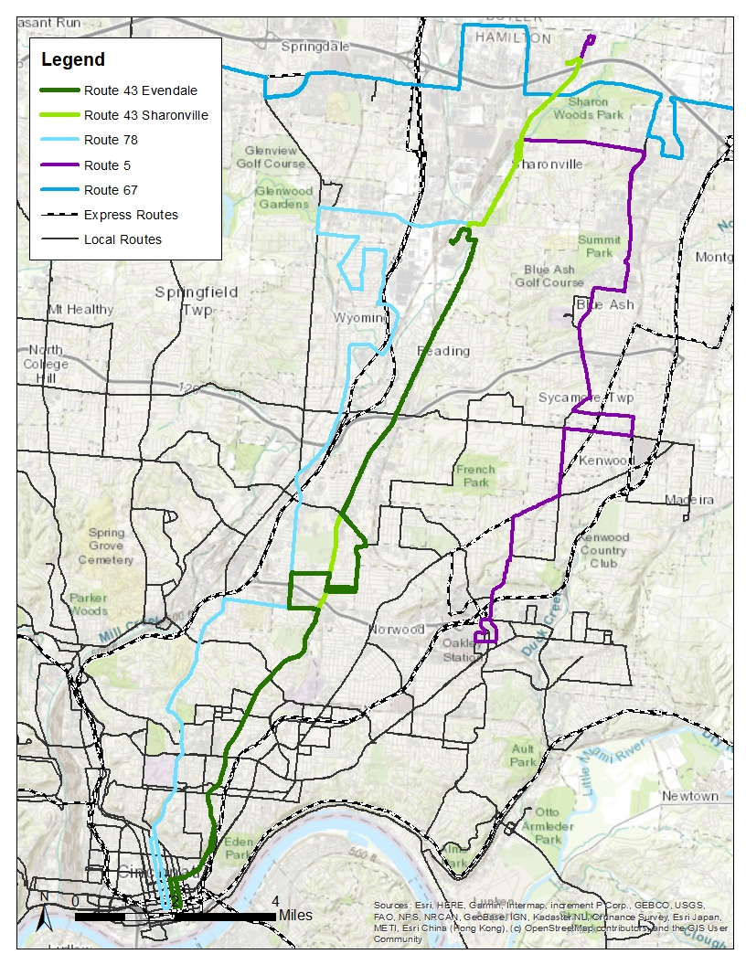
Route 43/Reading: Current v. Proposed
Sharonville Plaza
Evendale Walmart
Grueninger Way & Springfield Pike
GSQ
GSQ

Slide 5
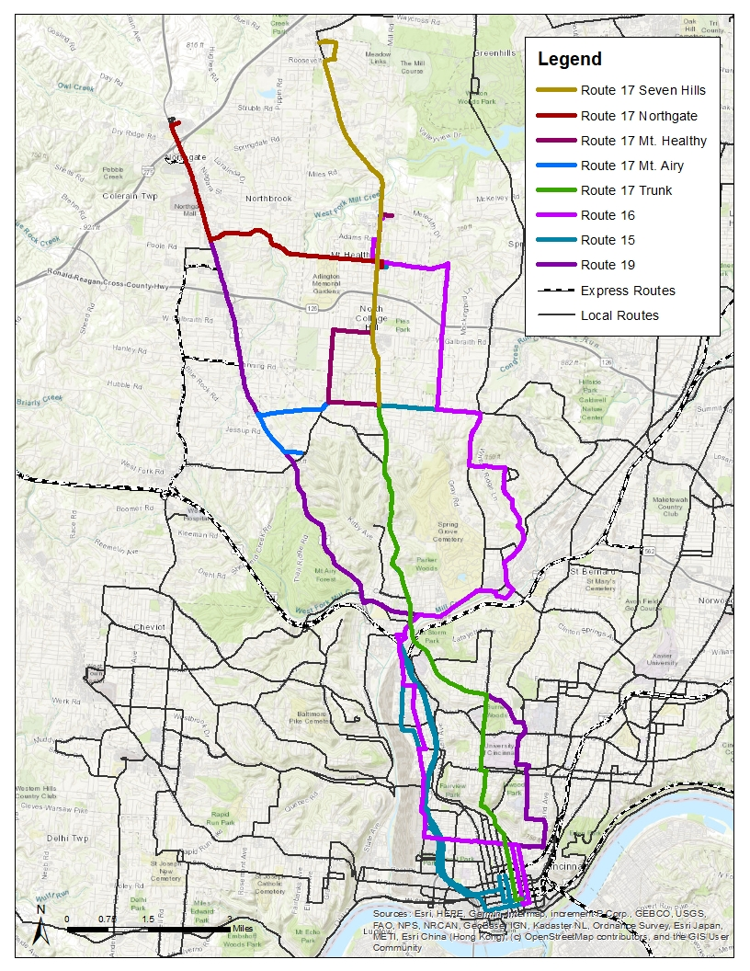
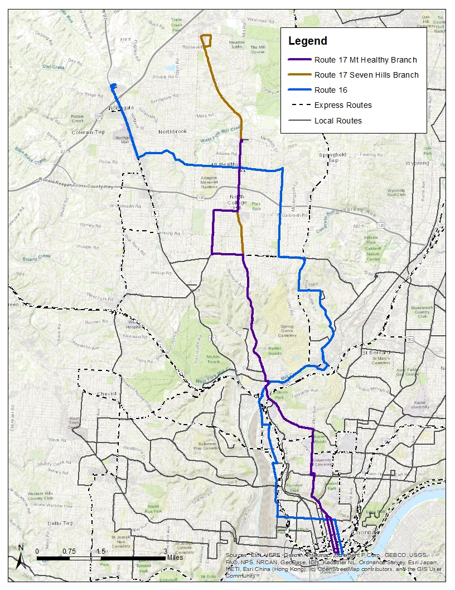
Route 17: Current v. Proposed
Seven Hills Center
Seven Hills Center
Colerain TC
Colerain Town Center
Kirby Ave & Colerain Ave
Northside TC
Northside TC
GSQ
GSQ
Notes:
New map for the Route 17/Route 16

Slide 6
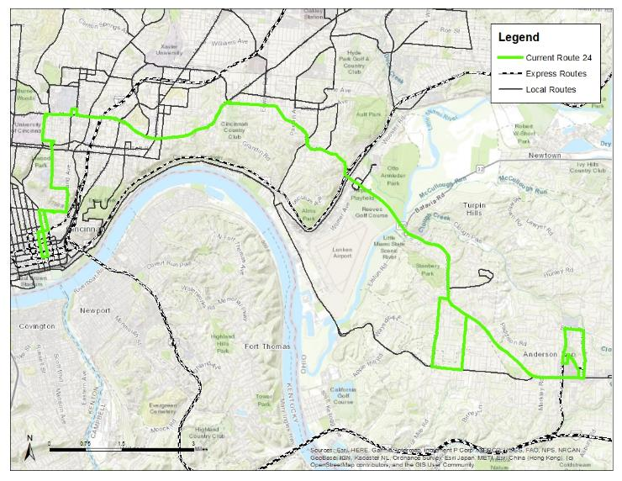
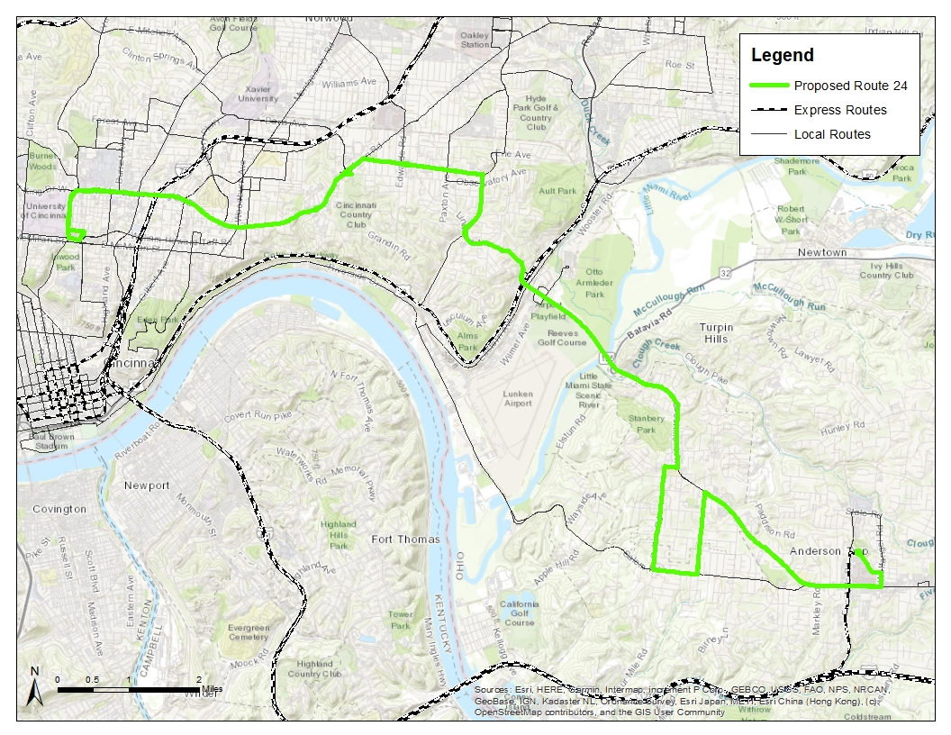
Route 24: Current v. Proposed
Corryville Kroger
GSQ
Anderson P&R
Anderson P&R
Notes:
Nick

